Slide 1
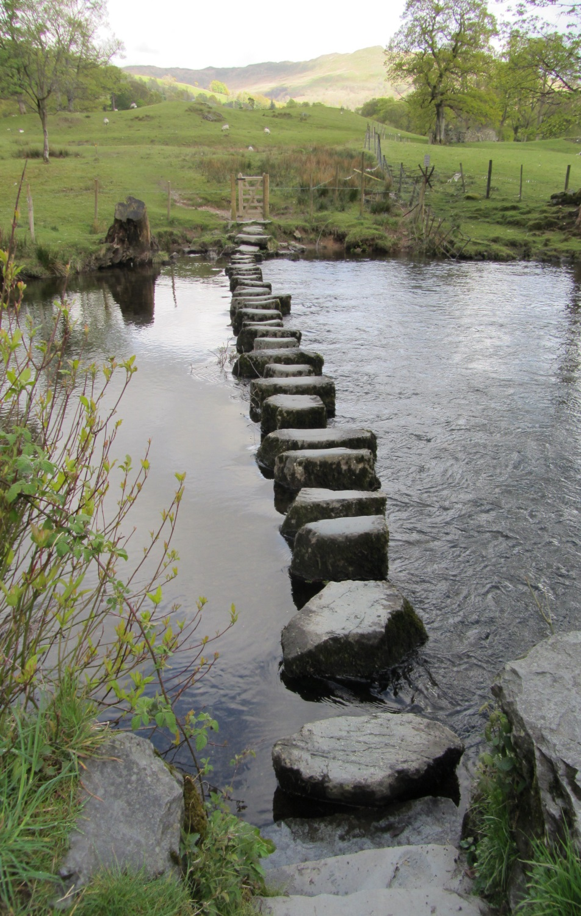
Semi-starvation on the journey to the UK
It’s impact on nutrition & the negative effects to physical & mental wellbeing

Slide 2

Learning outcomes:
The journey & link to nutrition
The journey & link to mental distress
The journey & link to physical distress
How to recognise semi starvation
Interventions that help the young people
Who to inform if you are concerned
(Palesty and Dudrick 147-154)

Slide 3

Reception centre staff reported that many of the young people ate very little and seemed to struggle to manage food.
This link’s to the
journey made
where a state of
semi-starvation
may have occurred over a number of
weeks, months or years.
(Palesty and Dudrick 147-154)

Slide 4
Evidence (what do we know about semi-starvation)
The Minnesota Starvation Experiment
A clinical study at the University of
Minnesota
The study determined the psychological
effects of severe and prolonged dietary restriction
During World War Two, conscientious objectors
in the US and the UK were asked to volunteer
for medical research.
("The Biology Of Human Starvation." 714)

Slide 5
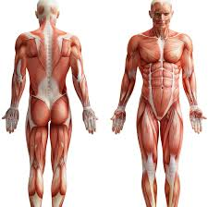
Physical symptoms of Semi-Starvation
Gastro-Intestinal discomfort
Decreased need for sleep
Dizziness
Headaches
Hyper sensitivity to noise and light
Reduced strength
Oedema (an excess of fluid causing swelling)
Hair loss
Decreased tolerance of cold temperature
Paraesthesia(abnormal tingling or prickling sensations, especially in hands & feet)
Decrease in metabolism (decreased body temp, heart rate & respiration)
(Palesty and Dudrick 147-154)

Slide 6

Psychological symptom's of Semi-Starvation
Binge eating & purging
Self-harming behaviours
A loss of interest in the future
Anxiety
Depression
A fascination with food (a high majority went on to become chefs)
(Reverby 134-136)

Slide 7
Who should I share my concerns with:
The young persons GP
Management in your institution or workplace
Paediatrics (if applicable)
Foster Carer (if applicable)
Social Worker as corporate parent
Support worker or Key worker (if applicable)
CAMHS (if applicable)
(Palesty and Dudrick 147-154)

Slide 8
Weight 4 height
Weight
Height
Gender
Age
Considerations need to
be made for cultural
difference & possible age
issues a child saying there
sixteen maybe older or
younger for a verity of reasons
("The Biology Of Human Starvation." 714)

Slide 9

The journey & nutrition story:
Information gathering of a young persons
diet on the journey to the UK, will give an
understanding of possible semi-starvation
Issues.
(Reverby 134-136)

Slide 10

Weight
4 Height
Calculator
http://www.awilkinson.eclipse.co.uk/w4h.html
("Re-Feeding")

Slide 11
http://www.rcpsych.ac.uk/pdf/CR168summary.pdf
Marsipan risk assessment framework
Traffic light system available at the following link:
Great
Ormand
Street
Feeding
Guidance
Great
Ormand
Street
Feeding
Guidance
Support
refeeding
programme which takes into account
cultural eating
Pattern
(N.p., 2017)

Slide 12
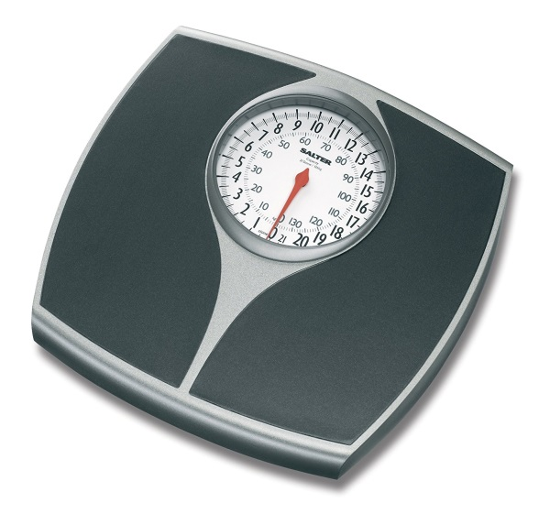


Refeeding
Programme
Refeeding programme that takes into account cultural and religious eating patterns
Manage via a MDT the manifestations of semi-starvations that emerge
Ensure staff are skilled to understand the issues of semi-starvation and refer concerns to other members of the MDT, according to the competences required
Support joint working in the re-feeding transition

Slide 13
Re-feeding plan example:
Day | one | Two | Three | Four
Breakfast | Small bowl of porridge | Small bowl of bran flakes | Small bowl of Weetabix | Small bowl of Shredded wheat
Midmorning snack | Banana and yogurt | Toast and jam | Crumpet and honey | Fruit salad
Lunch | Beans on toast | Scrambled egg on toast | Tuna salad with a roll | Sushi pack
Mid-afternoon snack | Crackers and cheese | Piece of fruit | Ice cream | Tea cake and butter
Dinner | Small portion of curry and rice/nan | Small portion of beef with potatoes and vegetables | Small portion of chicken with rice and vegetables. | Small portion of tuna pasta bake with vegetables.
Bedtime snack | Peanut butter on toast | Small bowl of granola | Prunes/figs and yogurt | Small bowl of muesli
(Palesty and Dudrick 147-154)

Slide 14
Reference:
Palesty, J. A. and S. J. Dudrick. "The Goldilocks Paradigm Of Starvation And Refeeding". Nutrition in Clinical Practice 21.2 (2006): 147-154. Web.
"Re-Feeding". Gosh.nhs.uk. N.p., 2016. Web. 9 Nov. 2016.
Reverby, S. M. "The Great Starvation Experiment: Ancel Keys And The Men Who Starved For Science". Journal of the History of Medicine and Allied Sciences 66.1 (2010): 134-136. Web.
"The Biology Of Human Starvation.". The American Journal of the Medical Sciences 220.6 (1950): 714. Web.
N.p., 2017. Web. 17 Jan. 2017.

