Slide 1
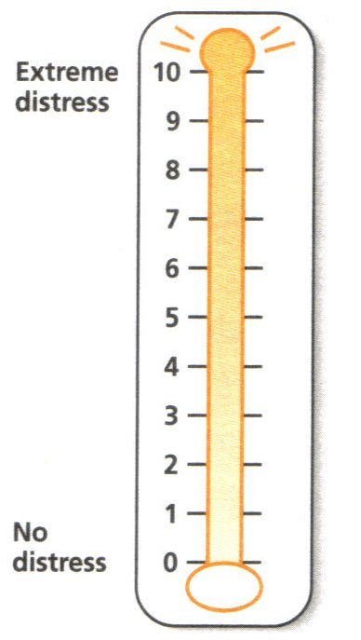
UASC distress screening
Please circle the number (0–10)
that best describes how much
distress you have been experiencing
in the past week including today.
Problem list:
Indicate if any of the following have been a problem to you in the past week.
Family:
Bereavement
Loss of contact with family
Concern about family safety
Emotional: Spiritual:
Fear Loss of hope
Anxiety Loss of spiritual
Nightmares practices
Hypervigilance Loss of spiritual
community
Physical: Unhappy with
Fatigue how living life
Constipation Loss of peace
Sleep
indigestion

Slide 2
UASC distress screening
Solution Focused Care Plan:
0 – 5: UASC does not require additional EM&WB support. Watch, wait and see protocol to be maintained. Level 2 clinician required from a competencies perspective.
6 – 7: UASC requires additional EH&WB support based on the Early Intervention
Framework and a level 3 clinician is required from a competencies perspective.
8 – 10: UASC requires additional EH&WB support and review based on the Early Intervention Framework and input from a level 4 clinician required from a
competencies perspective.
Solution process:
Is sleep work required and been undertaken? Yes No
Is re-feeding work required and been undertaken? Yes No
Is hope work required and been undertaken? Yes No

