Slide 1
Understanding the Health Needs of Unaccompanied Asylum Seeking And Refugee Children
Nancy Sayer
Designated Nurse for Looked After Children – Kent and Medway
Dr Georgie Siggers
Designated Dr for UASCs

Slide 2


Aims
Action
Awareness
UASC
Health
Support
Consequences
Massive rise in nos. arriving in Kent in 2015
Notes:
Neglect can have consequences for children that last lifetimes, if not generations
Need to raise awareness of the health implications
Need to lower threshold to report
Need to recognise & support long term effects
Define neglect
Think about why parents neglect
How can we recognise neglect
General health effects
Some science
Focus on emotional health
Briefly, what do we need to do

Slide 3
Legal Definitions
Asylum Seeker: applies to be given refugee status under the terms of the 1951 UNHCR Convention
UASC: A person who, at the time of making their asylum application is under 18 years of age or who, in the absence of documentary evidence, appears to be under that age and who is applying for asylum in his/her own right and is without a family member (s) or guardian (s) to turn to in this country

Slide 4
Legal Definitions
Refugee: this term is widely used to describe displaced people all over the world but legally in the UK a person is a refugee only when the Home Office has accepted their asylum claim
Some UASCs will later become refugees if their claims for asylum are sucessful

Slide 5
What is “seeking asylum”?
Asking for protection and permission to stay in the UK
The asylum seeker is seeking protection from persecution that has been suffered or that he/she is at risk of suffering because of his/her nationality, race or ethnic origin, political opinion, religion or social group in their country of origin

Slide 6
After full consideration by UK Visas and Immigration there is 1 of 3 outcomes:
Full Refugee Status: Meet definition of a refugee under the 1951 UN convention Relating to Refugees. Granted indefinite Leave to Remain after being in UK for 5 years. Not sent back
Humanitarian Protection or Discretionary Leave: HP: removal places serious risk to life or person.
DL: UASC under 18. Time limited & actively reviewed
Refusal: May appeal, if unsuccessful are removed from UK. If UASC not until 18
Imperative that the UASC has legal advice during the process

Slide 7
Where are our UASC coming from?
The majority are males aged 15 – 18
Country of Origin:
Eritrea
Syria
Afghanistan
Sudan
Kwait
Iran

Slide 8
What happens to them?
Female: Foster Care
Male under 16 years foster care
Male 16 – 18 years: Reception centres or independent living

Slide 9
Age Assessments
> 50 % births in the developing world not registered
Carried out only if:
no proof of age
Physical appearance/demeanor suggests that
they may be younger or older than claimed
The Home Office has disputed their age

Slide 10
Carried out by two social workers
Not a health responsibility but we should comment if appropriate
5 year margin of error (15 – 18)
If in doubt, assume is a child

Slide 11
Legal Responsibility
Looked After Child s20 of the Children Act: A duty to accommodate a child in need within their area where there is no person with parental responsibility for them or they have been lost or abandoned
Statutory Guidance: Promoting the health and wellbeing of looked-after children: Initial Health Assessment within 28 days of coming into care
Entitled to accommodation, health and education

Slide 12
Health
Massive vulnerabilities and risks
Experiences in country of origin
Traumatic journeys
Effect of malnutrition
Exposure to diseases not common in UK
Unmet screening and immunisation needs

Slide 13
What do we know about their health?
Based on an analysis of 104 YP seen in Millbank Oct – Dec 2015

Slide 14
Presence of dental decay

Slide 15
Visual Acuity

Slide 16
YP had concerns about their health
E.g. Dental pain, flashbacks, sleep difficulties, leg pain, abdominal pain, reflux, itching.
Scabies a huge issue
63/104
= 61%

Slide 17
Abnormal physical findings
e.g. Anaemia, dental caries, reduced visual acuity, possible leg fracture, multiple scars, skin rashes, heart murmurs, respiratory signs
20/104 Anaemic
11/104 had a heart murmur

Slide 18
Dr. concerned about YP’s mental health
e.g.Considered PTSD, traumatised, experienced CSA, witnessed parent’s murder, witnessed family members killed in bombing, sustained injuries in bombing, imprisoned and beaten en route to UK.

Slide 19
Immunisation status
BCG Scar Visible
Imms incomplete
100%

Slide 20
Other
12/104 were smokers (11%)
0/104 substance misuse
3/104 sexual health need
100% deemed high risk for BBV in view of country of origin

Slide 21
Health Responsibilities
Supporting immediate health needs
Long term care
Health Promotion
Safeguarding
Statutory health assessments
Initial Health Assessment (IHA)
Review Health Assessments (RHA)

Slide 22
The Statutory IHA
A holistic assessment of the child/YP’s physical, emotional and mental health
Key health issues for UASC:
Immunisations
Screening
Effects of malnutrition
Physical injuries (war wounds/torture/beatings)
Pregnancy/CSE/FGM/STI’s
Health Promotion

Slide 23
Case Study
17 year old Eritrean girl
6/12 journey to UK via Sudan, Libya, Italy, France. Raped as she crossed Sahara
Physical examination normal
Her main concern is her asylum claim

Slide 24
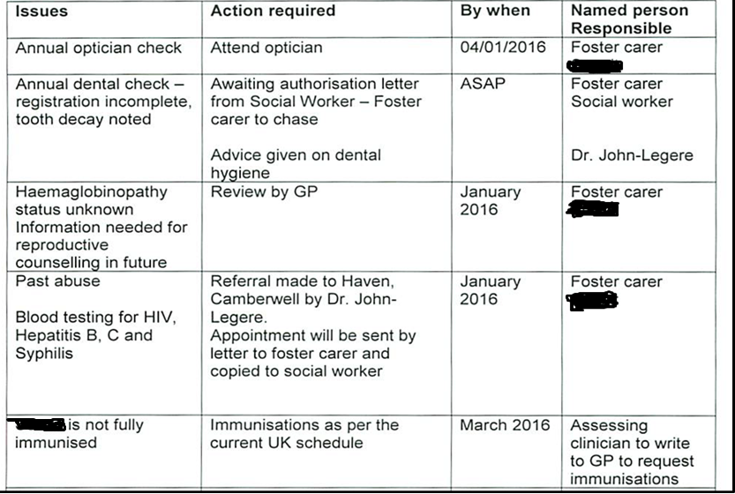

Slide 25
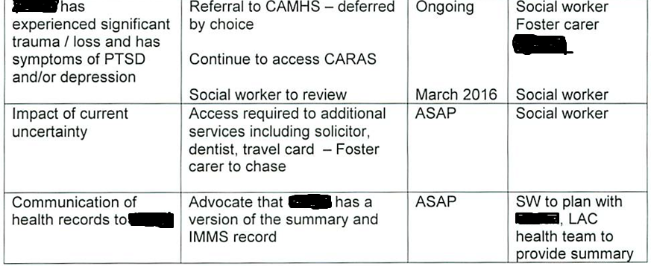

Slide 26
Case Study
15 year old Eritrean boy
Travelled through Sudan to Libya
Agents wanted money – imprisoned and beaten
c/o pain in left leg
Tender, fixed swelling medial aspect left tibia
Pain and clicking on flexion/extension

Slide 27
Issues | Action required | By when | Named person responsible
Traumatic travel | Counselling | 20.10.15 | PA/GP to refer CAMHS
Rotten teeth | Dentist appointment | 20.1015 | PA to arrange visit when has a permanent address
Fracture of the left tibia (possibly) | Should have x-rays and be seen by the GP | 30.9.15 | I will write to the GP requesting this
He can only see fingers with the left eye | Vision test, see GP | 20.10.15 | PA to take to Optician
Hearing | Has never been tested he needs a hearing screen | 20.10.15 | I will write to the GP to request hearing screen
Tuberculosis | He will need a Heaf test | 20.10.15 | I will write to the GP to request a heaf test
Vaccines | Will need to be immunized as per the current UK immunization schedule | 20.1015 | I will write to the GP to request
Screening for blood borne viruses Life skills | HIV , Hepatitis B, Hepatitis C and syphilis To develop life skills | 20.10.15 ongoing | I will write to the GP to request PA/SW/Millbank

Slide 28
Unmet health needs/risks
Immunisations – majority have no information
TB
Blood Borne viruses
Sickle cell
Emotional/Mental health
Anaemia

Slide 29
Safeguarding Issues
Remember their vulnerabilities and risks of:
Trafficking
Missing
Child Sexual Exploitation
Female Genital Mutilation
Radicalisation/PREVENT

Slide 30
What we need from Primary Care Services
UASC to have permanent GP registration
To hold the primary care record but enable this to be shared with the UASC
Action/follow up the Health Care Plan
Feedback to UASC Health team/Council UASC team – results, outcomes etc.
Make onward referrals

Slide 31
What can we do?
Undertake a holistic assessment of the UASC’s health
Identify actions
Highlight need for other services e.g. dental, vision, LAC CAMHs, specialist services
With your help develop a greater understanding of UASC’s health needs

Slide 32
Useful Websites
www.amnesty.org.uk (Amnesty International)
www.asylumaid.org.uk (Asylum Aid)
www.asylumscotland.org.uk (Scottish Asylum Seekers Consortium)
www.baaf.org.uk (British Association for Adoption and Fostering)
www.childrenslegalcentre.com (Children’s Legal Centre)
www.childrenssociety.org.uk/asylum (Children’s Society)
www.coramvoice.org.uk
www.ecre.org (European Council on Refugees and Exile)
www.indhomeoffice.gov.uk/ (Home Office)
www.homebeats.co.uk (Institute of Race Relations online resources)
www.iasuk.org/ (Immigration Advisory Service)
www.immigrationindex.org (Immigration resource directory including international news archives)
www.irr.org.uk (Institute of Race Relations – site to access SAD (Schools Against Deportation
www.jcwi.org.uk (Joint Council for the Welfare of Immigrants)
www.jrf.org.uk (Joseph Roundtree Foundation)
www.ncadc.org.uk (National Coalition of Anti-Deportation Campaigns)
www.paih.org (Positive Action in Housing)
www.refugeecouncil.org.uk (Refugee Council)
www.refugeesonline.org.uk (Information on training for asylum seekers and refugees in the UK)
www.refugeewelcometrust.org.uk (Refugee Welcome Trust)
www.rst.uk (Refugee Survival Trust)
www.savethechildren.org.uk (Save the Children)
www.scottishrefugeecouncil.org.uk/index.htm (Scottish Refugee Council)
www.stoptorture.org (Amnesty site for campaign against torture)
www.theirc.org/wcrwc (Women's Commission for Refugee Women and Children)
www.unhcr.ch (United Nations High Commission for Refugees)
www.wusuk.org (World University Service – refugee training and advice)

Slide 33
Looked After Children
Indigenous Population

Slide 34
Health of LAC vs. Peers
Two thirds of all looked after children enter care with at least one physical health complaint
Complaints include problems with speech and language, bedwetting, co-ordination difficulties and dental or vision problems
Vaccination programs are incomplete and routine developmental appointments missed
25% have a disability
Mental health and emotional well-being found to be significant
45% LAC were assessed as having a mental health disorder
In 5 – 10 year olds 50% of boys and 33% of girls identifiable mental health disorder
In 11 – 15 year olds 55% of boys and 45% of girls identifiable mental health disorder

Slide 35
Health of Young People Leaving Care
Young people leaving care are 2.5 times more likely to become teenage parents
Many aspects of young people’s health has been shown to be worse in the year after leaving care
Twice as likely to have a problem with drugs or alcohol (increased from 18% to 32%) and to report mental health problems (12% to 24%)
78% of sex workers who are also problematic drug users have been in care

Slide 36
Consent
Voluntary Accommodation Under Section 20 of the Children Act
Care Order
Parental Responsibility remains solely with the birth parent
Married parents or unmarried mothers and since 1st December 2003 unmarried fathers who are registered on the birth certificate gain parental responsibility automatically. Unmarried fathers who are not registered on the birth certificate or whose child was born before December 2003 have to apply to the court to acquire parental responsibility
Consent to be taken only from the birth parent that has parental responsibility. Social Worker should help facilitate this
Foster Carers and Social Workers cannot give consent
Parental Responsibility is shared with the local authority and birth parent.
The principle responsibility rests with the local authority
In the first instance Consent to be taken from the Service Manager of the local authority with responsibility for the child but can be taken from the birth parent that also holds parental responsibility.
Social Worker to advise and provide support in obtaining consent from either party.
Foster Carers and Social Workers cannot give consent

Slide 37
Consent Continued:
Special Guardianship Order
Parental Responsibility is given to the special guardian.
Birth parent retains residual parental responsibility. However, the special guardian is entitled to exercise parental responsibility to the exclusion of any other person with parental responsibility for the child (apart from another special guardian).

Slide 38
The role of primary care
Promoting the health and well-being of Looked-After Children (DfE &DoH, 2015)
Permanent registration of LAC
Timely access to a GP or other health professional when a LAC requires a consultation
Provide summaries of health history of a child who is looked after, including information on immunisations and covering their family history where relevant and appropriate, and ensure that this information is passed promptly to health professionals undertaking health assessments
Maintain a record of the health assessment and contribute to any necessary action within the health plan
Make sure the GP-held clinical record for a LAC is maintained and updated and that health records are transferred quickly of the child registers with a new GP practice, such as when he/she moves into another CCG area, leaves care or is adopted

Slide 39
References
Statutory Guidance on Promoting the Health and Well-being of Looked After Children (DfE & DoH, 2015)
NICE Guidance on Promoting the Quality of Life of Looked After Children and Young People (NICE, 2010)
Promoting the health of children in public care (Merredew and Sampeys, BAAF 2015)

Slide 40
Contact Details
Nancy Sayer
Designated Nurse for Looked After Children – Kent and Medway
Tel: 01634 335062/mobile: 07920278148
Email: nancy.sayer@nhs.net
Kim Henson
Lead Nurse for Looked After Children
Tel: 01634 838906/mobile: 07834929907
Email: khenson@nhs.net

