Slide 1
Claiming asylum as a child in the UK
Stewart MacLachlan,
Coram Children’s Legal Centre

Slide 2
Migrant Children’s Project
New website - free legal guidance & resources:
  www.coramchildrenslegalcentre.com
  Seeking support guide
Advice line:
  mcpadvice@coramclc.org.uk
  0207 636 8505 (Tuesday to Thursday 10am-12noon)
Outreach legal advice work
Training for statutory & voluntary sector professionals
Policy work

Slide 3
Definitions
Who is an asylum-seeker? A person applying for asylum.
Who is a refugee? A person who…
‘owing to a well founded fear of being persecuted for reasons of race, religion, nationality, membership of a particular social group or political opinion, is outside the country of his nationality and is unable or, owing to such fear, is unwilling to avail himself of the protection of that country’
1951 Refugee Convention (‘Convention Relating to the Status of Refugees’)

Slide 4
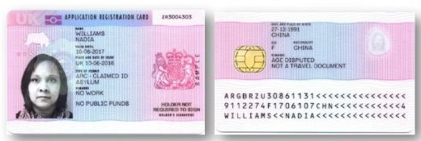

Asylum seekers
Potential circumstances
  Arrive unaccompanied
  Trafficked into the UK
  Change in circumstances at home
  Taken into care

Slide 5
The statistics
As of 2017 children account for just over 8% of all asylum applications

Slide 6
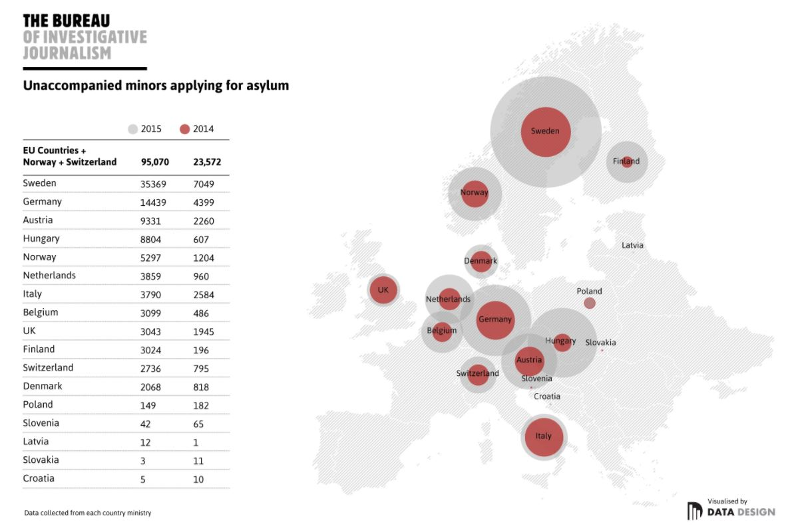
European context
Notes:
Greece:
2,100 UASC in March 2017
The national capacity for accommodating unaccompanied and separated children (UASC) is still far from meeting the needs – roughly half of the approximately 2,100* UASC in Greece currently do not receive adequate or appropriate care (UNHCR is supporting accommodation for half of the existing accommodation places for UASC in Greece). Moreover, greater emphasis is needed for the creation of other types of alternative care, e.g. foster families (care systems in host families – local or refugee families) and supervised independent living for older children (smaller group care for those 16-17 years old), where children would be placed based on their best interests.

Slide 7
Countries of origin
Top 9 child asylum applicant producing countries
Country | 2013 | 2014 | 2015 | 2016 | 2017
Sudan | 32 | 51 | 148 | 255 | 337
Eritrea | 131 | 460 | 736 | 413 | 320
Vietnam | 68 | 103 | 182 | 194 | 268
Albania | 470 | 632 | 481 | 420 | 250
Iraq | 6 | 32 | 182 | 324 | 248
Iran | 76 | 73 | 227 | 388 | 213
Afghanistan | 150 | 179 | 694 | 754 | 210
Ethiopia | 7 | 18 | 114 | 104 | 74
Syria | 64 | 118 | 169 | 140 | 41
In 2017 89% of applicants were male, which is similar to earlier years.

Slide 8
Age of child asylum-seekers

Slide 9
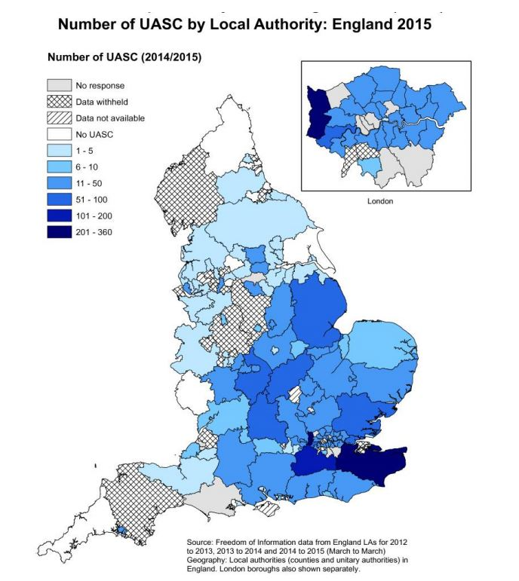
Care of unaccompanied children
Until July 2016, a child was the responsibility of the local council in which the child was present.
Children were not evenly distributed around the country – more children near airports, ports and in the South (near France)

Slide 10
National Transfer Scheme
Region | Transfers | 2016 | 2017
East Midlands | Out In | 12 30 | 0 24
East of England | Out In | 21 32 | 69 150
London | Out In | 50 4 | 168 1
North East | Out In | 0 10 | 0 13
North West | Out In | 0 17 | 0 50
South East | Out In | 148 54 | 153 36
South West | Out In | 1 46 | 3 51
West Midlands | Out In | 0 10 | 1 35
Yorkshire & Humber | Out In | 0 28 | 0 44
Established July 2016.
The intention is to share the
responsibility for looking after
unaccompanied children
between local councils, and
ensure the burden is not
unmanageable for councils in
the south east of England and
London.

Slide 11
Care of unaccompanied children
Children Act 1989
General duty under Children Act 1989 (section 17) to assist ‘children in need’
Enforceable duty under Children Act 1989 (section 20) to accommodate where a child requires accommodation
Presumption of section 20 support for unaccompanied asylum-seeking child
Leaving care support owed to those who have been looked after for at least 13 weeks subsequent to their 14th birthday – until at least 21 (until 25 if still being helped by the local authority with full-time education or training)

Slide 12

The Asylum Process
welfare interview
National Transfer Scheme
statement of evidence form
asylum interview
further evidence
decision

Slide 13
The asylum process
Decisions
  Refugee Status
  Humanitarian Protection
  UASC Leave
  Outright refusal
Appeal/next steps
  RS (5 years)
  HP (5 years, refusal of RS)
  UASC Leave (2.5 or until 17.5, refusal of RS and HP)
  Outright refusal (no leave)
  ***Refusal of refugee status/HP = appeal***

Slide 14
Children’s asylum decisions
Notes:
Of the decisions made on unaccompanied children’s claims in in 2017, 55% were refugee status.
Until 2013 the majority of decisions on asylum applications by unaccompanied children under the age of 17 were grants of discretionary leave.
A new category, UASC leave, was introduced in 2013 and is now used in cases where the only reason for giving leave is that the applicant is a child who cannot be returned, and this means that there are now far fewer grants of discretionary leave than in the past.
Unaccompanied children who have reached the age of 18 have generally been more likely to have their asylum claim refused.
For decisions on unaccompanied children who have reached the age of 18 there was a refusal rate of 57% in 2016 but the refusal rate dropped in 2017.

Slide 15
Complications
Age Assessment
Trafficking (NRM referral)
Mental health issues/engaging with the process
Dublin III Regulation
  Regulates responsibility for asylum claim (European countries)
  May be transferred to UK/Home Office may seek to remove back to Euro country
  Third Country Unit
National Transfer Scheme
  Potential delays
  Issues with care
  Updated protocol – March 2018

Slide 16

Contact us
The Migrant Children’s Project
Free legal guidance and resources
www.coramchildrenslegalcentre.com
Email advice
mcpadvice@coramclc.org.uk
MCP advice line
020 7636 8505
Tuesday to Thursday, 10am-12noon

