Slide 1
Supporting mental health needs of unaccompanied young people
Rupinder Parhar,
The Children’s Society

Slide 2
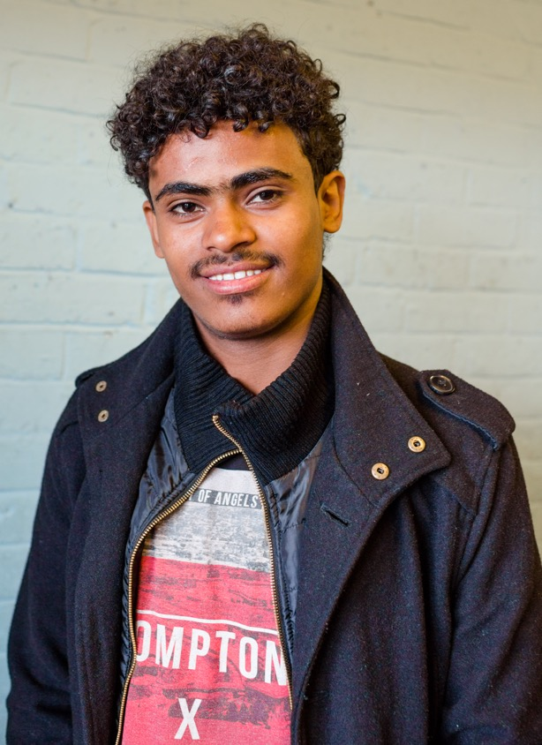

Terminology
Refugee
Unaccompanied asylum seeking young person
Separated young person
Age disputed
Asylum
UASC leave
Refugee status
ARE
Section 55 duty
UNCRC
www.refugeecouncil.org.uk/glossary

Slide 3
The Children’s Society support for refugee children
The Children’s Society has supported refugee children since 1939: helped to look after children arriving in London via the Kindertransport.
Children were supported with trauma, they were all arriving alone and many had lost their parents in tragic circumstances.
We have continued to support refugee and migrant children, unaccompanied and in families, through to present.
www.childrenssociety.org.uk/news-and-blogs/our-blog/our-history-with-child-refugees

Slide 4

The Children’s
Society’s Services
Services across England, specialist services for refugee and migrant children in Newcastle, Leeds, Lancashire, Manchester, Birmingham and Stratford.
Direct advocacy and advice work, group work, befriending, social activities and therapeutic support.
Campaign work and lobbying on issues that affect refugee and migrant young people, representing their views and issues that affect them to decision-makers on local and national level in England and Wales.
www.childrenssociety.org.uk/what-we-do

Slide 5
Therapeutic support for refugee and migrant young people
Historically, The Children’s Society ran therapeutic services in Liverpool (bereavement service), London (Finsbury Park project in partnership with African Women’s Welfare Group) and Oxford (therapeutic service for psychological distress and trauma): worked with refugee and unaccompanied children on an individual basis, in groups, or within families.
Currently, we provide in-house mental health support in our Rise project in London and through our Pause drop-in service in Birmingham.

Slide 6

Legal framework for supporting unaccompanied children
Section 20, Children Act 1989
duty to accommodate children
Section 17, Children Act 1989
to safeguard and promote wellbeing of children in area, including support for parents
Section 31, Children Act 1989
enables local authority to create a formal court order to place a child in its care, bestowing parental responsibility.

Slide 7
Agron’s story
17 year-old from Albania, trafficked and working in a car wash.
Supported by the Children’s Society’s trafficking service for boys.
One-to-one advocacy, focusing on safety and wellbeing.
Agron faced sleep disturbances, nightmares based on difficult experiences.
Accessed in-house therapist to address sleep disturbance and nightmares. Initially the nightmares increased, but therapy caused a decrease in nightmares.
Reduced nightmares, feels calmer, less fearful of his traffickers.
He will decide whether he wishes to access further therapeutic support.
www.childrenssociety.org.uk/news-and-blogs/our-blog/our-history-with-child-refugees

Slide 8
Issues that young people require support for
Fleeing violence
Bereavement
Trauma
Trafficked
PTSD
Sleep disturbances
Starvation
Sexual abuse and STDs
Anxiety
Nutrition issues
Social isolation
Age assessments
Inability to access to services they need e.g. education, NHS care
Homelessness/difficulties with accommodation
Self-harm and suicide

Slide 9
Assessing needs of separated and unaccompanied young people
For LAC assessment, conducted, in accordance with
Department of Health guidance on looked-after children by a paediatrician as soon a possible.
Assessments conducted with input from social workers, foster carers,
residential workers and other relevant adults that are supporting a young person.
SDQ does not always capture full need. Need a full range of assessment tools that assess trauma, attachment and subjective wellbeing in a culturally sensitive way.
Providing for a young person’s language and interpretation needs.
There might be limited access to historical health information, family health history.
Immediate issues that need attention upon arrival:
injuries, trauma, starvation or other malnutrition, pregnancy,
sexual health issues.

Slide 10
Barriers to accessing mental health issues and stress
Inadequate models for assessing need
CAMHS criteria might not suit mental health needs of unaccompanied young people
Awareness among professionals
Language and lack of interpretation
Support to understand and articulate needs
Home Office immigration and asylum processes
Age assessments
Risk of return at 18
Legal aid cuts
Lack of coordination among services
Cuts to NGO support services
Hostile Environment – NHS charging, restrictions to education access
Limited support for children in families: Dublin III

Slide 11
Assadullah’s story
17 year-old from Afghanistan, taken from his family to a Taliban training camp.
Helped to escape and taken across the border to Iran, smuggled across Europe to the UK.
Taken to a police station. Police arranged for him to be assessed by children’s services. He was initially taken into care of children’s services.
He then had his age assessed as 20 year-old. He was moved out of local authority care into asylum accommodation with adult men, without the child-specific support he needed.
Experiencing flashbacks, hearing voices. Referred by GP to Freedom from Torture.
Supported with his trauma, but he was not able to access age-appropriate education and other support and this had a detrimental impact on his recovery and rehabilitation.
www.childrenssociety.org.uk/news-and-blogs/our-blog/our-history-with-child-refugees

Slide 12
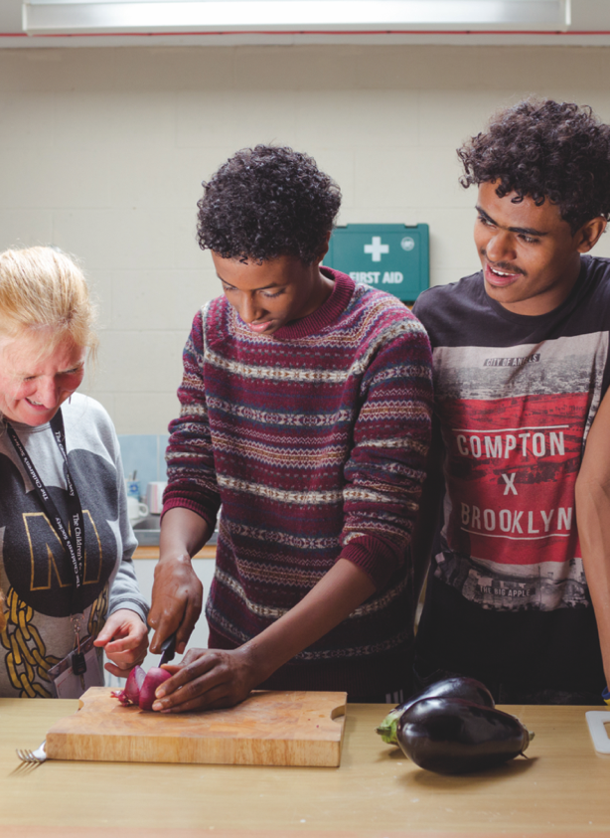
Successful support
Comprehensive and flexible referrals and assessments.
Trusted, community-based therapeutic support.
Training for key professionals such as social care, foster carers and residential workers that support separated and unaccompanied young people.
Leadership to ensure consistent communication about young people’s needs and joint working between professionals.
Advocacy support also provided for young people to support practical needs.
Independent legal guardians for young people.

Slide 13
Successful support
Flexible duration of time spent working young people.
Adaptable language and resources used to discuss mental health with young people.
Continuous commitment to funding for CAMHS, specialist mental health and advocacy services for children and 18+ young people.
High quality, supportive accommodation placements.
Varied therapeutic interventions (individual, group, etc.) where appropriate
Improved support and communication from Home Office immigration and asylum processes.
Access to appropriate legal advice and legal aid.
Equal access to support for Dublin III family reunion arrivals.

Slide 14
Access to legal aid
Cut off from Justice
Access to high quality immigration advice and funding for asylum or other immigration applications has been repeatedly highlighted as a key issue for ensuring young people’s wellbeing and stability.
Wide sweeping cuts were made to the legal aid landscape by the government in 2012.
We are asking the government to reinstate legal aid in immigration cases for under 18s.
Read our two reports about access to legal aid, released in 2013 and 2017, and support the campaign.
www.childrenssociety.org.uk/legal-aid-support

Slide 15

Thank you
Rupinder Parhar
rupinder.parhar@childrenssociety.org.uk
@ChildSocPol
Find out more about our work with refugee and migrant children at www.childrenssociety.org.uk/what-we-do

