Slide 1


Unaccompanied Asylum
Seeking Children
Disordered sleep patterns

Slide 2
Aims
Listen to the stories UASC tell in their own voice
Recognize why UASC experience reversed sleep patterns
Understand symptom's of reversed sleep patterns
Comprehend reversed sleep patterns, mimicking the symptom's of Post Traumatic Stress Disorder, ADD & Mania
Learn UASC project sleep Interventions: sleep advice, sleep packs & reverse sleep calculator

Slide 3
Listen to UASC in their own words
https://youtu.be/7pcV7FJp0hU

Slide 4
Contextual disordered sleep patterns: The journey though Europe.
Its safer to sleep in the day-light
Risks of beatings or imprisonment if caught without papers, so travel at night
Huddle in groups to sleep for warmth and safety
In the cover of darkness attempts made to board trucks
Traffickers operate in the cover of darkness

Slide 5
Understand disordered sleep patterns & sleep
Deprivation: These can resemble symptom's of post
traumatic stress disorder, attention deficit disorder & psychosis
Increased blood pressure
Increased stress hormone levels
Increased risk of diabetes
Increased risk of fibromyalgia (condition that causes pain all over the body
Irritability
Nystagmus (Involuntary eye movement)
Obesity
Seizures
Temper tantrums in children
Yawning
Aching muscles
Confusion, memory lapses
Depression
Development of false memory
Hallucinations
Hand tremor
Headaches
Malaise (uneasiness-restlessness)
Stye
Peri-orbital puffiness
Mania

Slide 6
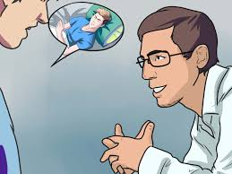
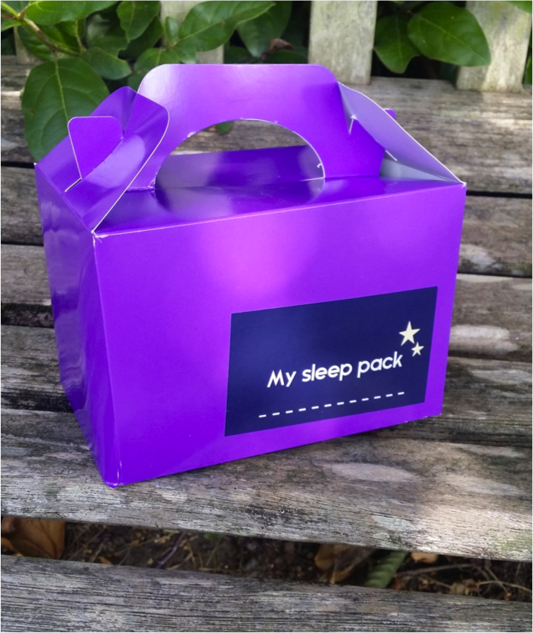
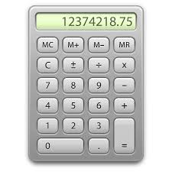
Sleep Interventions:
Practical sleep Advice, sleep Pack &
Reverse sleep calculator

Slide 7

Good Sleep
Sleep hygiene presentation
Notes:
GOOD SLEEP

Slide 8

Sleep Packs
Sleep mask
Ear Plugs
Night light
Lavender

Slide 9
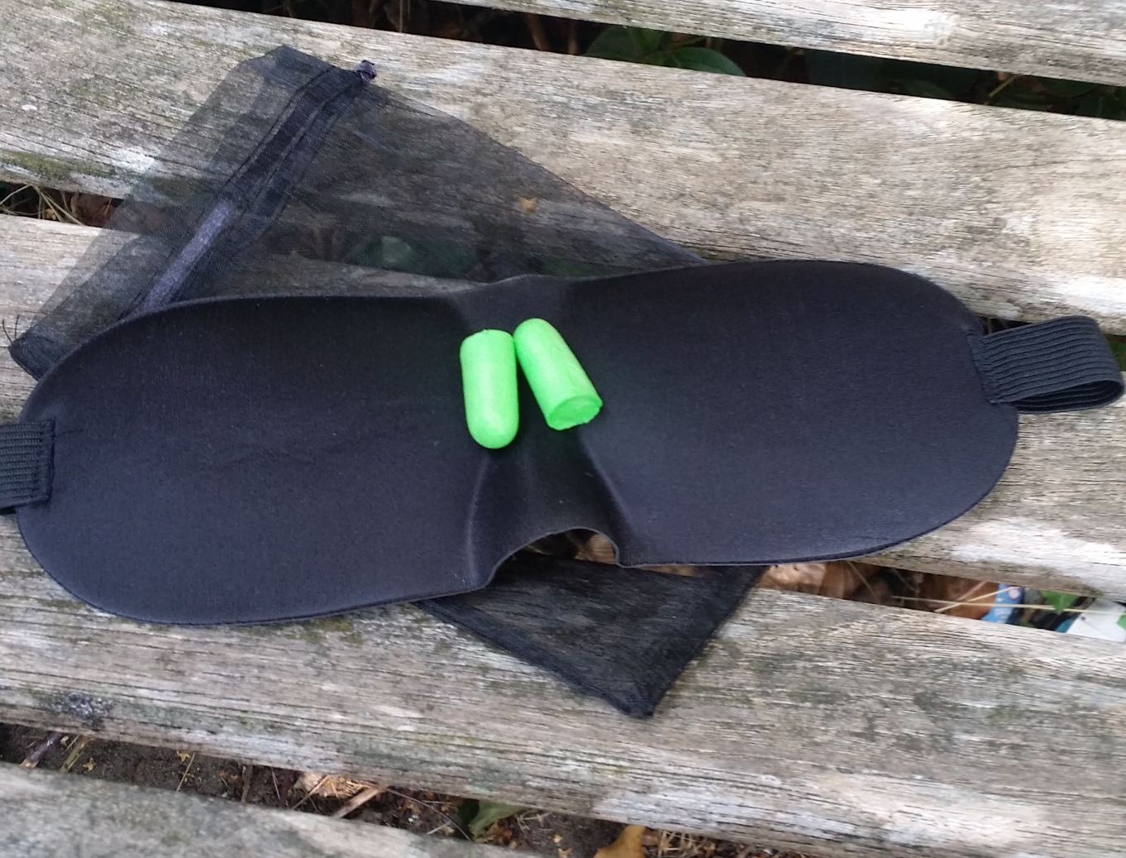
Sleep Mask & Ear Plugs

Slide 10
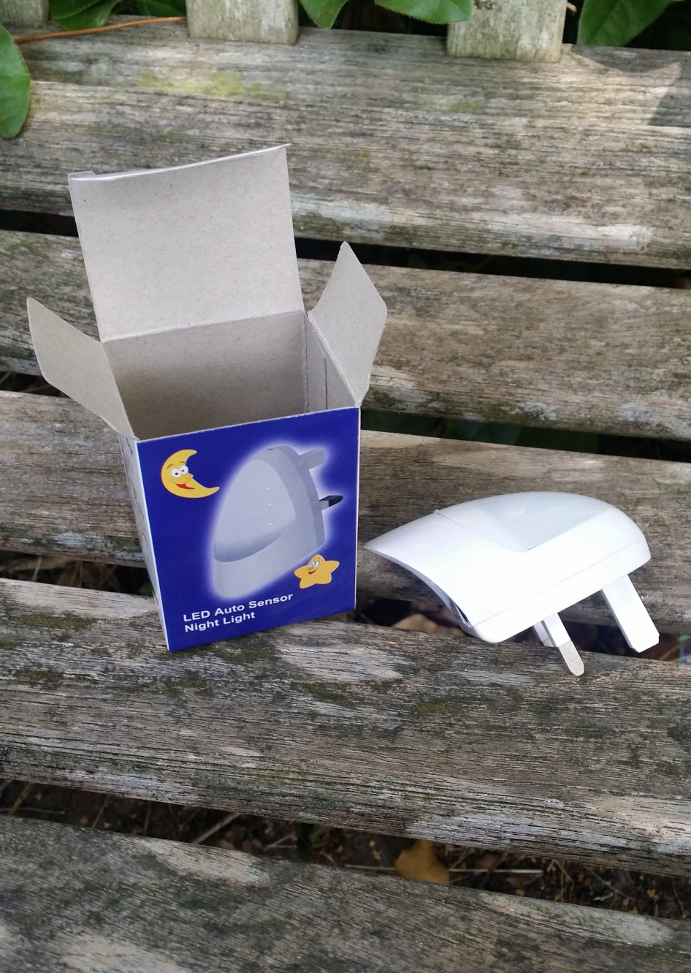
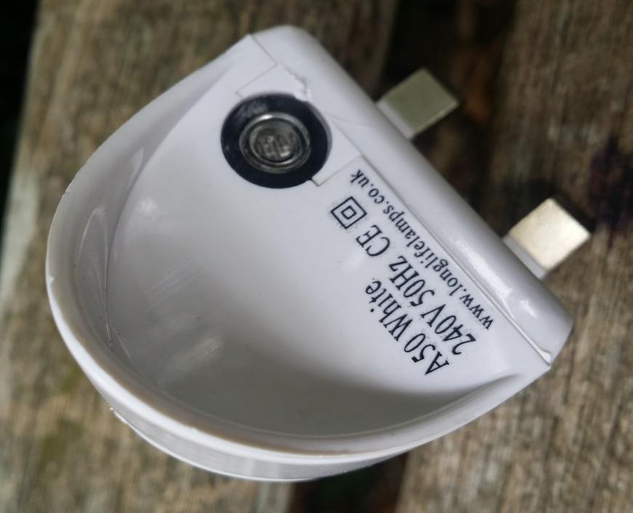
Night - Light

Slide 11
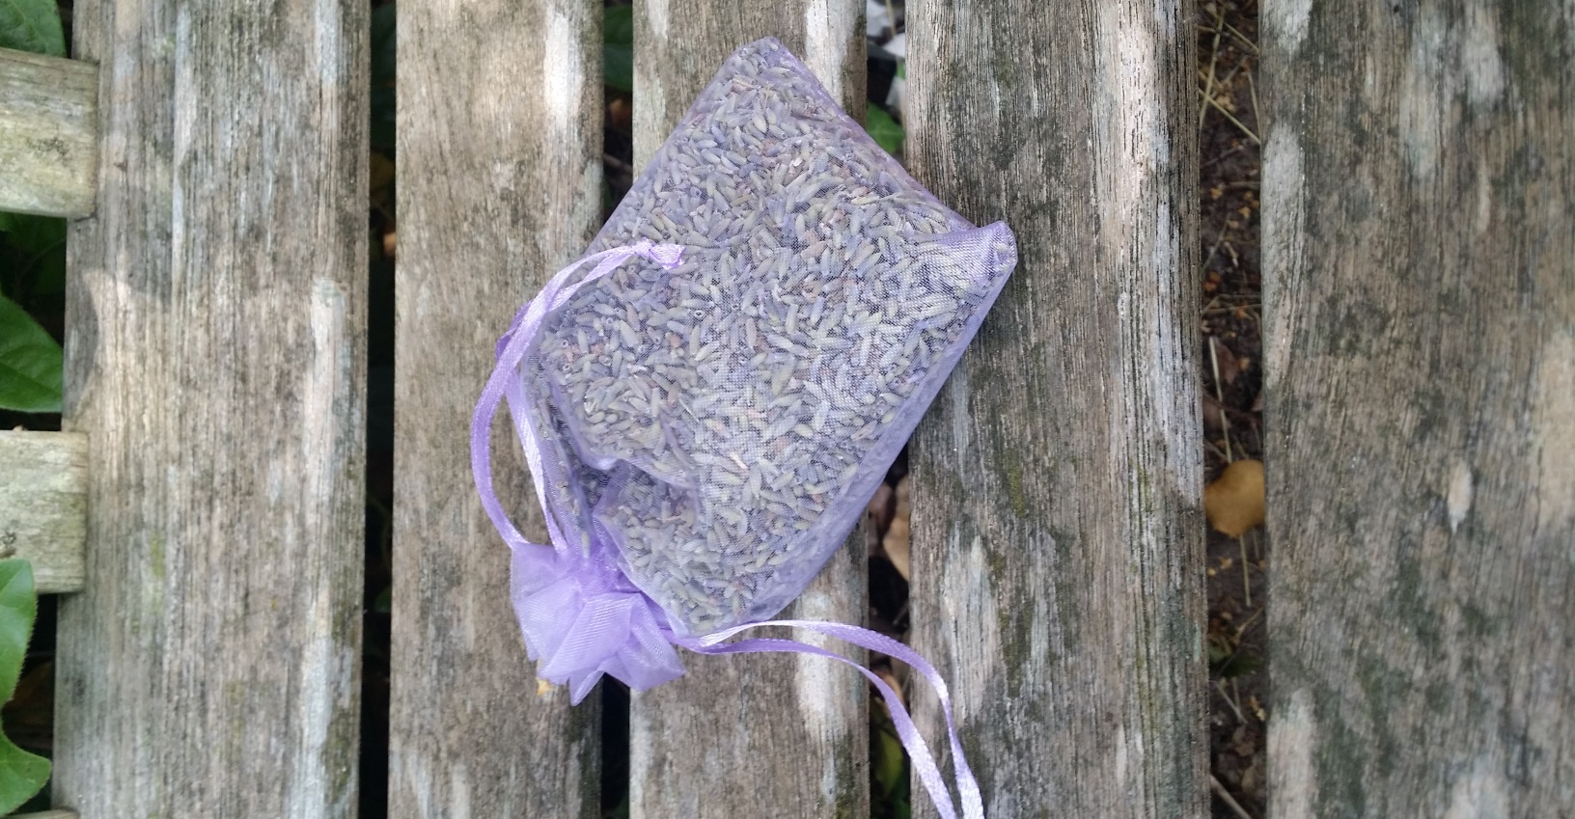
Lavender can help with Sleep

Slide 12
Sleep Body Clock
CALCULATOR:
How it works
How to use it

Slide 13
Reference
Anon, (2016). [online] Available at: http://cks.nice.org.uk/
insomnia#!scenario [Accessed 9 Jun. 2016].
Ferber, R. (2006). Solve your child's sleep problems.
New York: Fireside Book.
Meadows, G. (n.d.). Sleep well every night.
Nhs.uk. (2016). Sleep problems and trouble sleeping
- Live Well - NHS Choices. [online] Available at: http:
//www.nhs.uk/Livewell/sleep/Pages/sleep-home.
aspx [Accessed 9 Jun. 2016].
Stevenson, S. (n.d.). Sleep smarter.

